Slide 1
Design Study

Slide 2
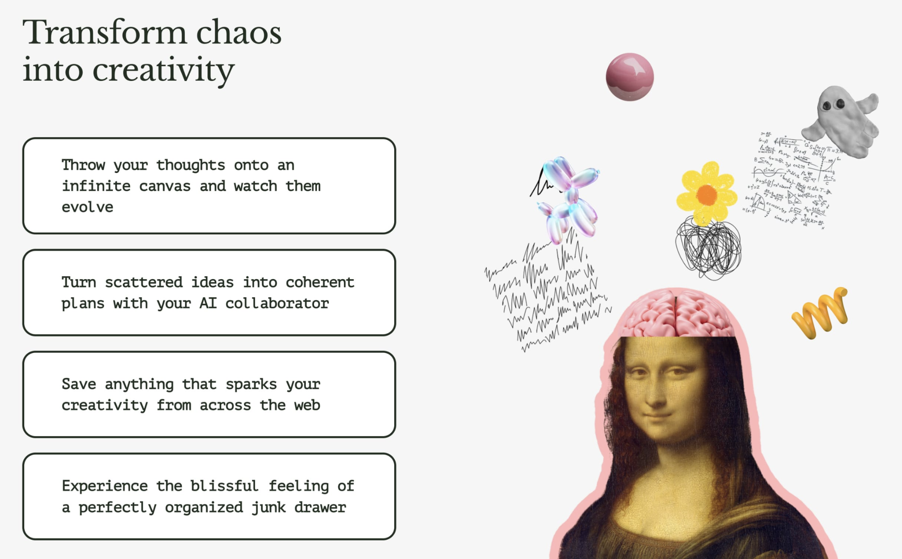
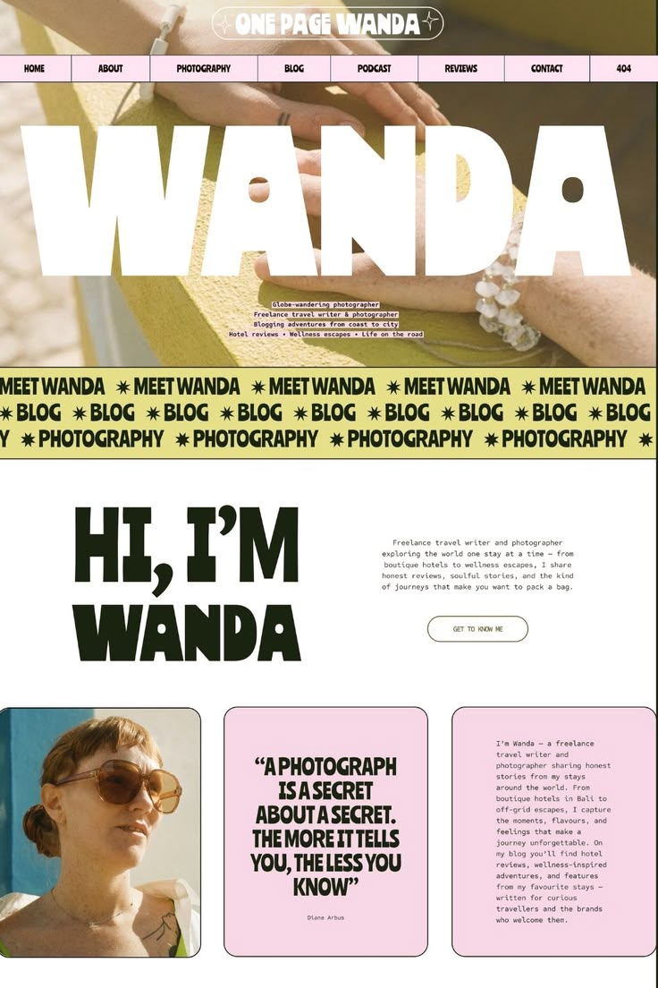
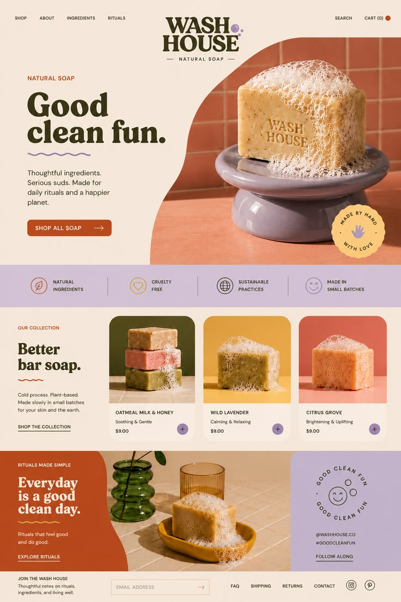

Clean feeling/font
Warm colors
Big Descriptive Icons/Interesting textures
Bold topography, Sense of calm
Griffy Font

Slide 3
